Slide 1
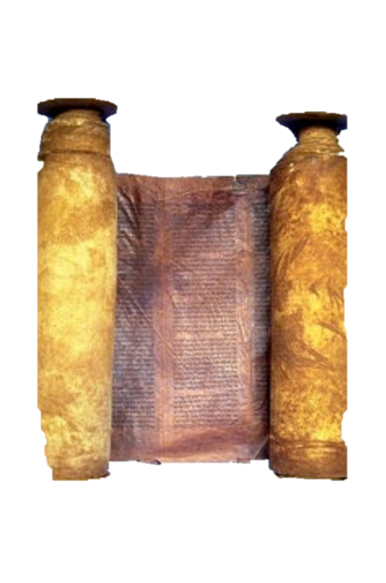
A free CD of this message will be available immediately following the service
2 Kings
1-2
A podcast will also be available later this week at calvaryokc.com

Slide 2
2 Kings
(c. 852 - 562 BC)
850 BC
800 BC
750 BC
700 BC
650 BC
600 BC
2 kings 1-2

Slide 3
2 kings 1-2

Slide 4
Baal-Zebub ~ Lord of the flies
2 kings 1-2

Slide 5
2 kings 1-2

Slide 6
Hairy man ~ ba`al se`ar – owner (lord) of hair
2 kings 1-2

Slide 7
2 kings 1-2

Slide 8
A hill ~ literally, the hill
2 kings 1-2

Slide 9
2 kings 1-2

Slide 10
1 kings 1-2

Slide 11
1 kings 1-2

Slide 12
Mal. 4:5-6 ~ ⁵ Behold, I will send you Elijah the prophet
Before the coming of the great and dreadful day of the Lord.
⁶ And he will turn
The hearts of the fathers to the children,
And the hearts of the children to their fathers,
Lest I come and strike the earth with a curse.
2 kings 1-2

Slide 13
2 kings 1-2

Slide 14
Youths ~ KJV, little children
Isaac, 28
Joseph, 39
Sodomites at Lot’s house
Mauled ~ cleave or divide
2 kings 1-2

Slide 15
2 kings 1-2

